Slide 1
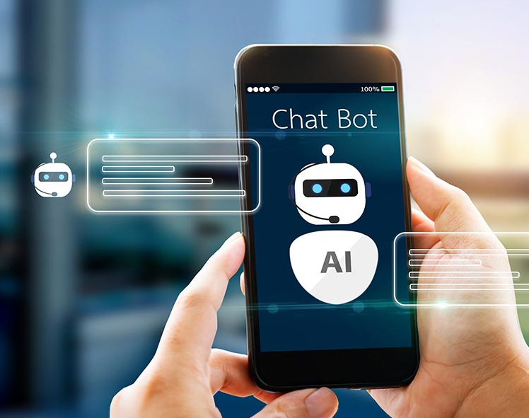
Teams Bot using Azure Language service
By Navkirat Singh

Slide 2
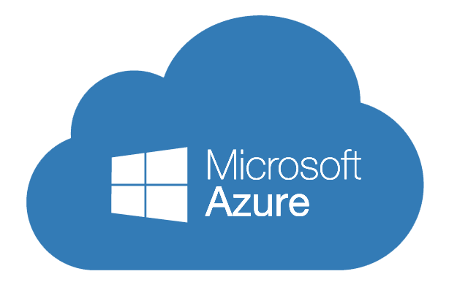
All Azure Services Used
- Azure Language Service (QnA Maker-style) - Azure AI Search - Azure Blob Storage - Azure Bot Framework (Web App Bot) - Azure Private Endpoints - Azure Virtual Network (VNet) - Azure Application Gateway (with WAF) - Microsoft Teams (Channel integration)

Slide 3
Azure Services & Their Roles
S.No | Azure Service | Purpose / Use
1 | Azure AI Language (Language Studio) | Create and manage QnA project for natural language understanding
2 | Azure AI Search | Indexes content from Blob Storage to enable intelligent search queries
3 | Azure Blob Storage | Stores documents like PDFs, DOCX, TXT for knowledge base
4 | Azure App Service / Function App | Hosts the backend logic of the bot (serverless)
5 | Azure Private Endpoints | Secures services by restricting access to the VNet
6 | Azure Virtual Network (VNet) | Isolates all Azure resources in a secure private network
7 | Azure Application Gateway | Exposes the bot with HTTPS, routing, and WAF protections
8 | Microsoft Teams | Acts as the client platform for interacting with the QnA bot

Slide 4
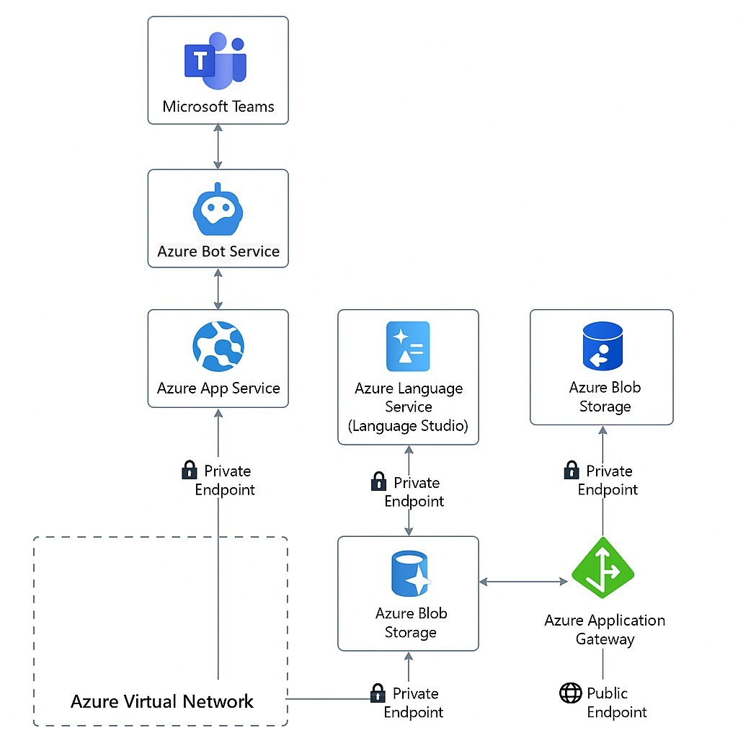
Architecture Diagram
Description:
Microsoft Teams interacts with the Azure Bot service.
Bot is connected through the Azure Application Gateway for secure HTTPS access.
The gateway routes traffic to an Azure App Service or Function App via a Private Endpoint.
The App connects to:
Azure AI Language Studio to handle QnA logic
Azure AI Search to perform document semantic searches
Azure Blob Storage as the source for documents
All components are deployed inside a Virtual Network (VNet) for isolation and security.

Slide 5
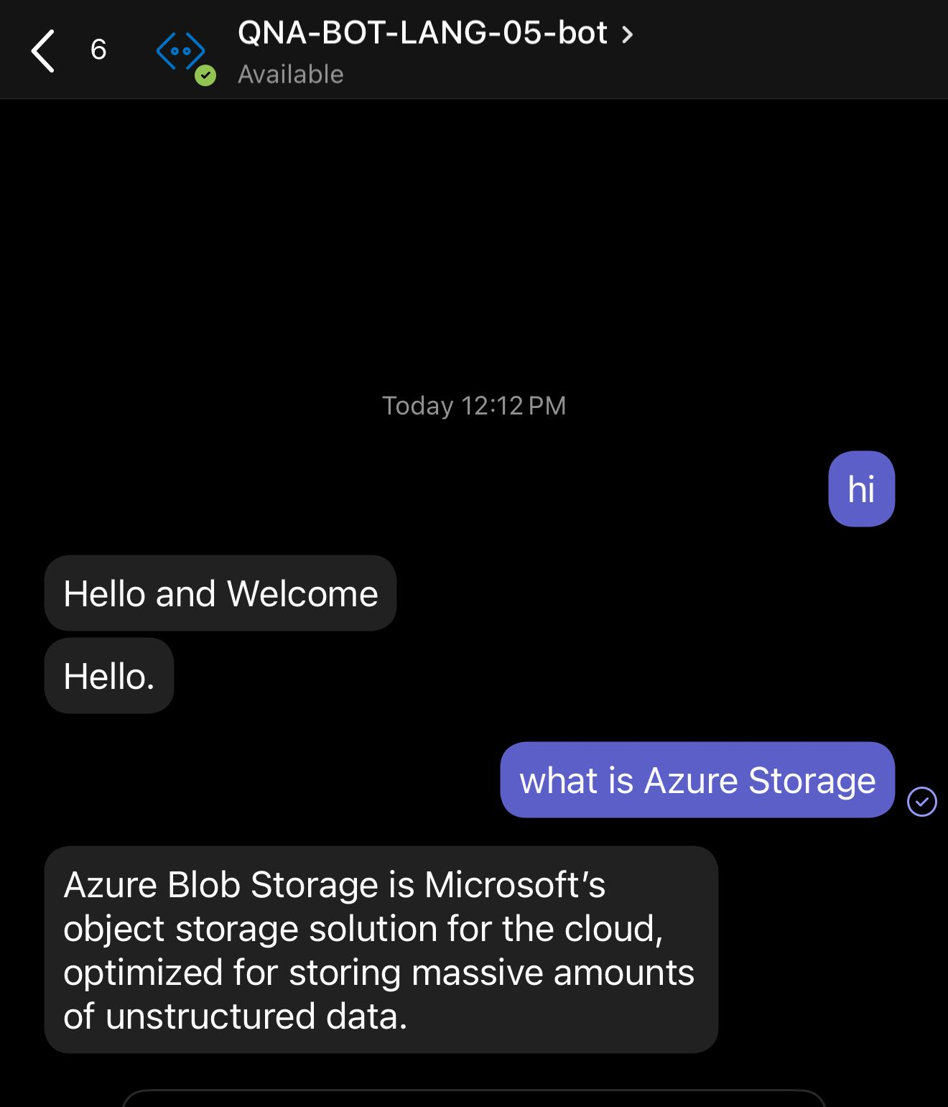
Output
Users can ask questions in Microsoft Teams.
The bot replies intelligently using Azure AI Language Studio and Search.
It fetches answers from the Blob-stored documents.
The bot respects enterprise compliance and privacy via Private Endpoints.
All interactions are secured using TLS via Application Gateway.

Slide 6
THANK YOU

